Slide 1
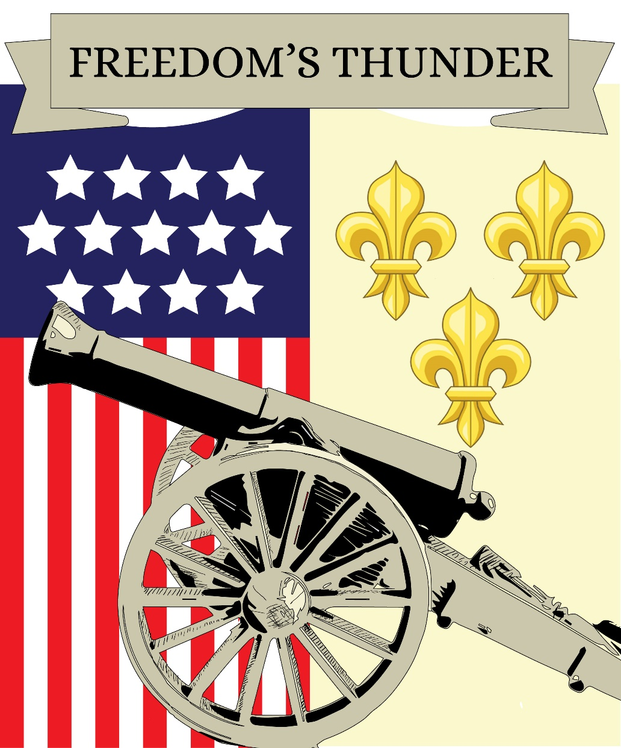
N.S.C.A.R. Museum
Freedom’s Thunder 2016-2017 Exhibit

Slide 2
N.S.C.A.R. Museum
20’ x 63’ located on the 2nd floor of the DAR Building between N.S.C.A.R. Headquarters and DAR Officers Club.
Fifty-eight cases of different sizes devoted to:
Actual children who were born and lived during the American Revolution
The National Project— Freedom’s Thunder
N.S.C.A.R. past and present
Programs of the National Chairmen

Slide 3
National Curators
National Curator: Emily Ruhm
Senior National Curator: Gregg McCullough

Slide 4
ARMY
Some support for the National Project (the American Revolution Museum at Yorktown) came from the sales items seen in these cases.

Slide 5
Bunker Hill
On June 17, 1775, Abigail Adams and other citizens of Boston and the surrounding area, awoke to sounds of the Battle of Bunker Hill. Losses include the death of Sons of Liberty leader Dr. Joseph Warren.

Slide 6
Charter of Freedom
The Declaration of Independence was adopted by the Second Continental Congress on July 4, 1776. On the committee to write the Declaration included Thomas Jefferson, John Adams, and Benjamin Franklin.

Slide 7
Diplomats
Diplomats, such as Benjamin Franklin were essential in the American victory by negotiating with allies and creating pacts

Slide 8
Patriotic Education
N.S.C.A.R. prides itself on its patriotic education programs that teach young people about US history and pride, such as the US Flag Code.

Slide 9
Four Chaplains
They were four Army chaplains who gave their lives to save other civilian and military personnel as the SS Dorchester sank on February 3, 1943 during World War II. They helped other soldiers board lifeboats and gave up their own life jackets when the supply ran out.

Slide 10
Battle of Germantown
In the middle of the Battle of Germantown on October 4, 1777, George Washington rescued a dog! Find more about this by reading the book shown.

Slide 11
Independence Hall
Independence Hall was known as the Pennsylvania State House when Thomas Jefferson, John Adams, John Hancock and Benjamin Franklin were there for the Second Continental Congress.

Slide 12
American Indians
They are an important part of US History. To honor them, we learn about their culture and history.

Slide 13
Join C.A.R.
N.S.C.A.R. has a long history and expansive membership. These cases showcase that history. Shown are the insignia and original gavel that opened the first National Convention of N.S.C.A.R as well as our charter and original National Convention ribbons from the early 1900’s.

Slide 14
Kids During the Revolution
Sixteen year old Sybil Ludington rode all through the night- even longer than Paul Revere to let the patriots know of the British attacking in Danbury, Connecticut. Sybil is just one example of how children made an impact during the Revolution.

Slide 15
First Ladies
First Ladies serve as important figures in American history. Abigail Adams is shown here. She is one of our best know “founding ladies” and just one of several first ladies featured in the museum.

Slide 16
Moutain Schools
NSDAR established and continues to support six mountain schools. N.S.C.A.R. contributes to these schools through donations and the sales of the Mountain Schools pin.

Slide 17
National Parks
The National Park’s Service is currently celebrating its centennial. The conservation chairman this year has focused on this monumental occasion.

Slide 18
Officer’s Uniform
Our War of 1812 Coatee is an example of the type of uniforms worn by officers in the American Revolution.

Slide 19
Postage
Mail and letters were vital during the Revolution as they served as the main way of communication over long distances.

Slide 20
John Quincy Adams
John Quincy Adams was born July 11, 1767 in the town of Braintree, Massachusetts literally grew up right during the American Revolution facing the hardships along with his mother and siblings while his father served Congress.

Slide 21
Paul Revere
“One if by land and two if by sea” Paul Revere saw two lights in the Old North Church on his Road to Independence in 1775 and made his famous ride.

Slide 22
Service Dogs
Service dogs assist veterans who suffer from physical and mental disabilities. They can help in a variety of ways, like navigation, serving as balance, or providing emotional comfort.

Slide 23
Turning Point
Battle of Saratoga took place for eighteen days in the fall of 1777. Victory at Saratoga convinced France and Spain to aid the American cause.

Slide 24
Valley Forge
On December 19, 1777, George Washington and his troops marched in to Valley Forge, PA. Despite a hard winter, disease, and lack of food, the troops became a real army during this time and became stronger.

Slide 25
Washington’s Crossing
On December 25, 1776, George Washington surprised the Hessian soldiers who were fighting for the British at their camp in Trenton, New Jersey by crossing the Delaware River.

Slide 26
Extra Special Item
George and Martha Washington helped to raise two of their four grandchildren at Mount Vernon after Martha’s son died at the end of the Revolution.
This baby bonnet made by Martha herself in 1797 for one of her great grandchildren. This is the museum’s most precious item on display. It was donated by Mr. John Pappas of the Jeremiah Crane Garthwaite Society in New Jersey in 1977.

Slide 27
Yorktown
On October of 1781, the American Revolution was ended with the Battle of Yorktown when the British were surrounded by the Americans and the French Troops. Every October, N.S.C.A.R. remembers this great victory by participating in the Yorktown celebrations.

Slide 28
HuZZah!
A term used by colonists to express joy. Now every year America expresses joy and gratitude during the 4th of July and other patriotic holidays.

